Slide 1
Chapter 5 Memory Hierarchy--Outline
Basic idea of memory hierarchy
Principle of locality
Cache
Virtual memory

Slide 2
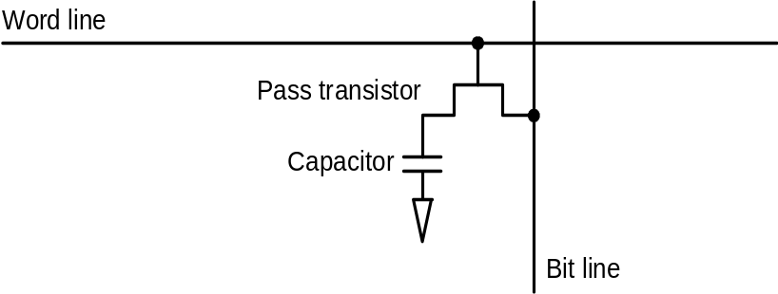
Memories: Review
SRAM:
  value is stored on a pair of inverting gates
  very fast but takes up more space than DRAM (4 to 6 transistors)
DRAM:
  value is stored as a charge on capacitor (must be refreshed)
  very small but slower than SRAM (factor of 5 to 10)
W
o
r
d
l
i
n
e
B
i
t
l
i
n
e
Bit line

Slide 3
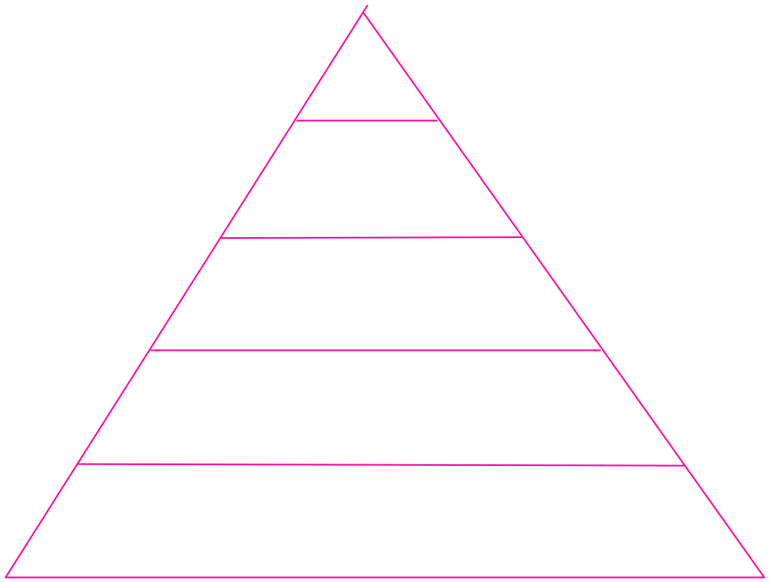
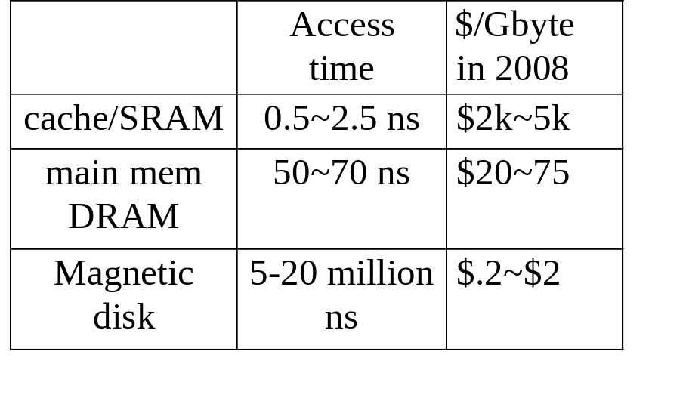

Memory Hierarchy
Multi-levels of memories with different speeds & sizes
Upper level & lower level
any upper level lower level
Reg
Cache, SRAM
main mem./DRAM
Disk
Magnetic tape/optical disk

Slide 4
Why Memory Hierarchy?
Processor-DRAM performance gap growing
Two goals (speed and size) conflict
Principle of locality: program access a relative small portion of their address space --- if an item is referenced
  it will tend to be referenced again soon --temporal locality
  nearby items will tend to be referenced soon-- spatial locality
How memory hierarchy works
Goal of memory hierarchy: to achieve
  speed of highest level (cache)
  size of lowest level (disk)

Slide 5
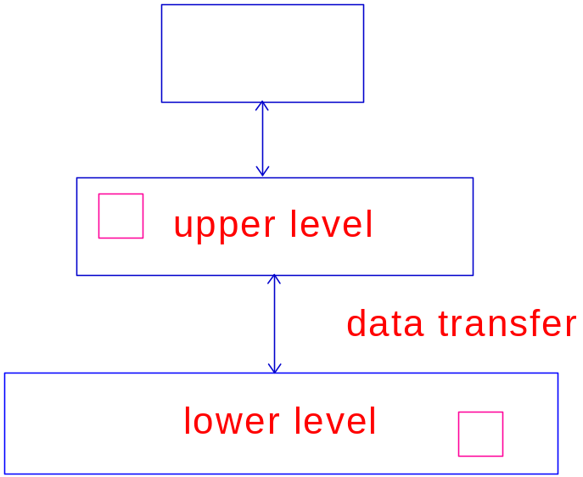
Terminology
How a processor access a memory hierarchy
  access upper level first
  if a miss, retrieve the whole block
  containing the requested data
Block (line) a set of consecutive words
in memory with the same block address
Hit
Miss
Hit rate = #hit/#access
Miss rate = 1 - hit rate
miss penalty: time to move the block to upper level
Why transfer the whole block instead of the requested data ?
processor

Slide 6

Big Picture
Principle of Locality
  temporal
  spatial
Memory hierarchy
  keep recently accessed data closer to processor --- temporal
  moving blocks consisting of multiple contiguous words to upper level --- spatial
Goal of memory hierarchy
  memory access time highest (fastest) level
  memory size lowest (largest) level

Slide 7
Four Questions in Designing Memory Hierarchy
Address mapping from lower level to upper level?
How to find the requested data in the upper level?
Which block to be replaced?
Write?

Slide 8
Cache: interface b/w cache & main memory
direct mapped cache
fully associative cache
set associative cache
"direct mapped"
  For each item at the lower level, there is exactly one location in the cache where it might be.
  e.g., lots of items at the lower level share locations in the upper level

Slide 9
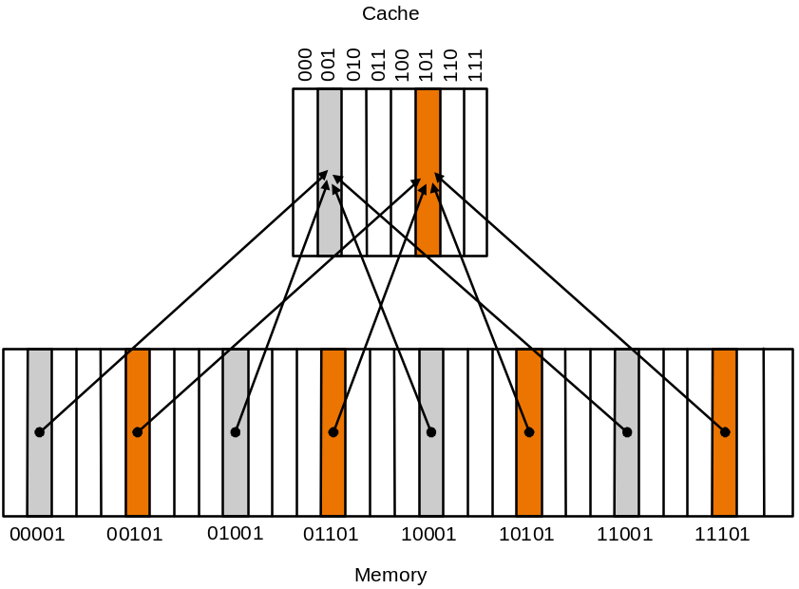
Direct Mapped Cache
Mapping: address is modulo the number of blocks in the cache
_{Block size =1}

Slide 10
Cache with Direct Address Mapping
Lower-order 3 bits of M. address = C. index
  Memory locations with the same lower-order 3 bits share the same cache location– due to spatial locality
The block in cache to be replaced is fixed
How do I know if the data is what I want?
  Tags: consist of higher-order bits of memory addresses

Slide 11




Format of a Word in Cache
Valid = 1, valid address
0, this cache location is empty
Tag: remaining bits (higher order) of memory address
Example :
memory size =
cache size =
tags: 5-3=2 bits
When CPU accesses cache, check both valid and tag

Slide 12
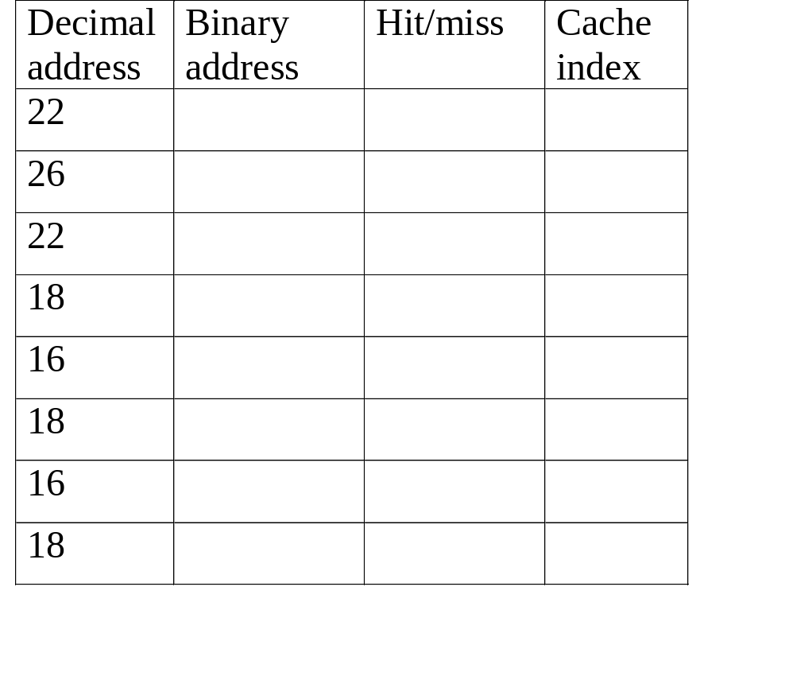
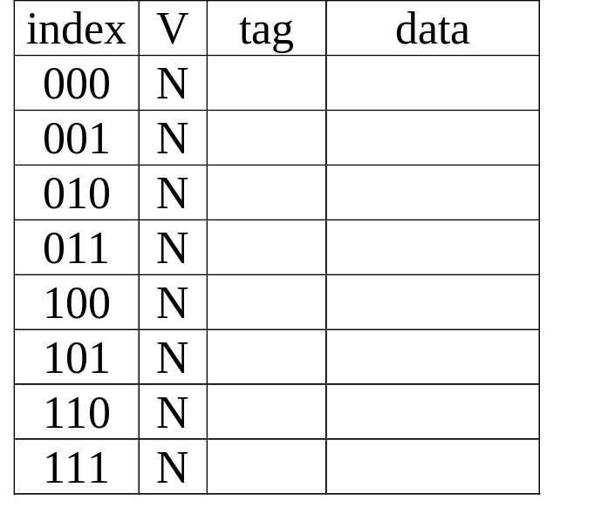
Example, block size = 1 word
memory size = 32 blocks, cache size = 8 blocks
Access sequence: 22, 26, 22, 18, 16, 18, 16, 18
_{Cache content}

Slide 13
Block size =2
How to form blocks: memory locations with the same block address
Block offset:

Slide 14

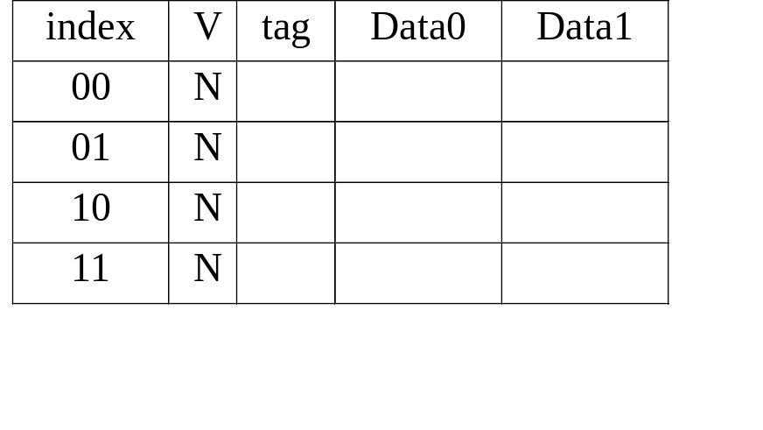
Example 2, block size=2
memory size = 32 words (16 blocks), cache size = 4 blocks,
Access sequence: 22, 25, 23, 26, 16, 18, 16, 18

Slide 15
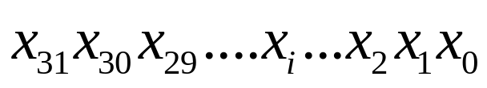


Direct Mapped Cache-- Address Translation
Memory address with 2 bits byte offset:
Cache size: blocks
Block size : words
Address translation: how to figure out cache index from the memory address?
How many bits needed to implement the above cache?

Slide 16
Direct Mapped Cache – MIPS (block size=1)
A
d
d
r
e
s
s
(
s
h
o
w
i
n
g
b
i
t
p
o
s
i
t
i
o
n
s
)
3
1
3
0
1
3
1
2
1
1
2
1
0
o
B
y
t
e
f
f
s
e
t
b=0, r=10
Low portion: select cache entry
higher 20 pits: compared with tag
total # bits in the cache?
H
i
t
2
0
1
0
D
a
t
a
T
a
g
I
n
d
e
x
I
n
d
e
x
V
a
l
i
d
T
a
g
D
a
t
a
0
1
2
1
0
2
1
1
0
2
2
1
0
2
3
2
0
3
2
What kind of locality are we taking advantage of?

Slide 17
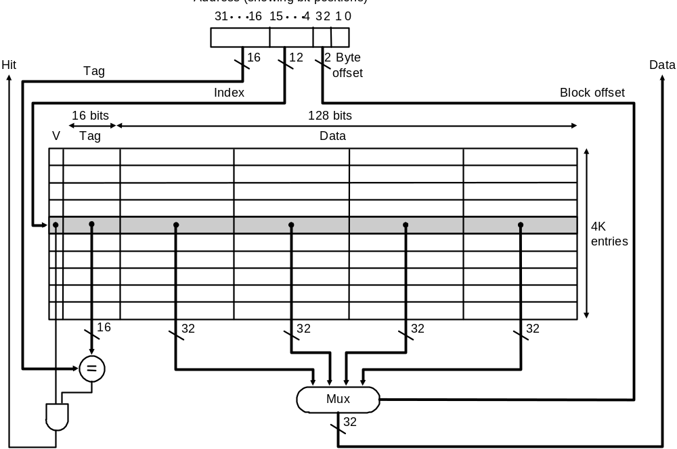
A 64 kb Direct Mapped Cache with 4 Word Block
b=2, r=12, tag: 16 bits (=32-2-2-12)
cache index:12 bits
Block offset: selects one word in a block
Taking advantage of spatial locality

Slide 18
Cache -- Direct Mapped-- Summary
Each block in main mem. only one fixed location in cache
  many one mapping
  replacing: replace the block occupying the location
  cache index = lower-order bits of memory address, excluding byte and block offset
Advantages
Disadvantages

Slide 19
Hits vs. Misses
Read hits
  this is what we want!
Read misses
  stall the CPU, fetch block from memory, deliver to cache, restart
Write hits: 2 write policies
  write-through: update data in cache and memory right away
    write buffer:a queue holding data to be written to memory
  write-back: update data in cache only (update memory later)
Write misses:
  read the entire block into the cache, then write the word

Slide 20
How to Handle Cache Miss
Basic idea: stall CPU (not interrupt) & do the following
  send the address of the miss item to memory
  instruct memory to perform a read & wait for memory to complete the access
  Write cache entry (data portion, tag, valid flag)
  restart
Miss penalty: setup time + block size

Slide 21
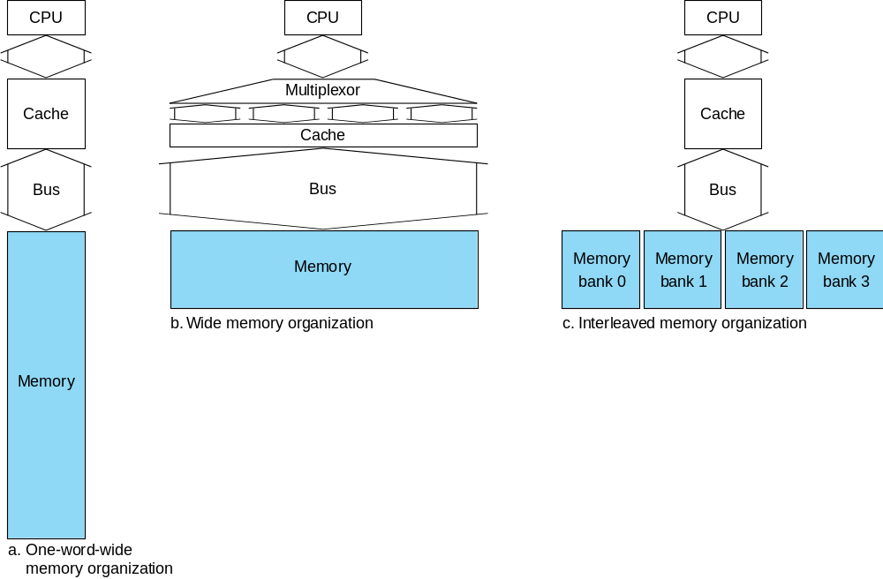
Designing Memory to Support Cache
Design a memory with higher bandwidth by increasing
  physical width: wide memory
  logic width: interleaved memory

Slide 22
Performance
Simplified model:
execution time = (execution cycles + stall cycles) × cycle time
stall cycles = #misses × miss penalty
    #misses= #I cache misses +#D cache misses
    miss penalty=
Two ways of improving performance:
  decreasing the miss ratio
  decreasing the miss penalty
Separate caches for instruction and data

Slide 23
Cache Misses: 3 C’s
Compulsory miss (cold start misses): A cache miss caused by the 1st access to a block that has never been in the cache.
Capacity miss: A cache miss that occurs because of the cache size.
Conflict miss (collision miss): A cache miss that occurs when multiple blocks compete for the same set while other sets are available.

Slide 24
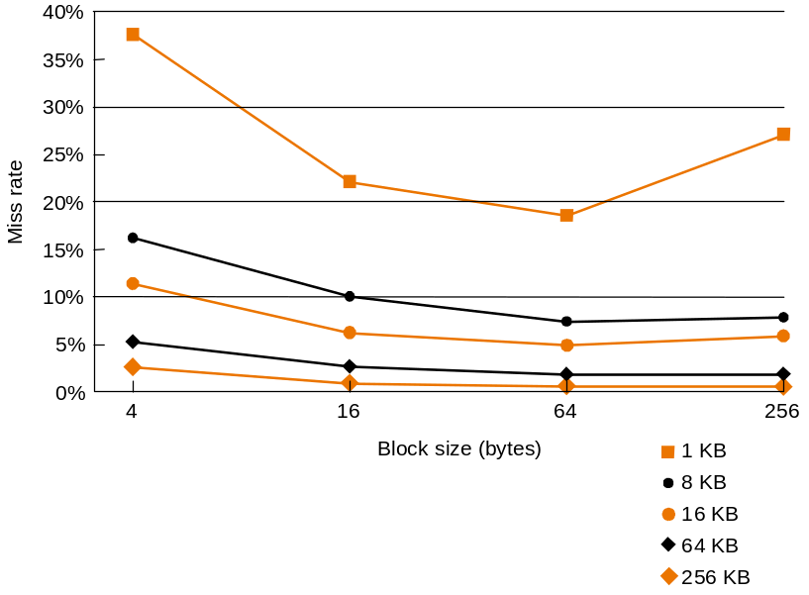
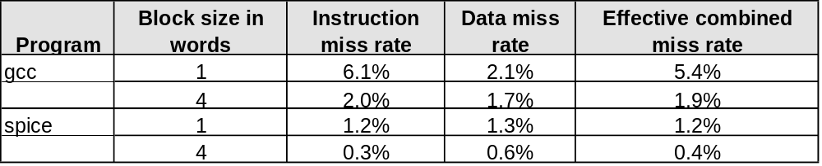
Increasing the block size tends to decrease miss rate:

Slide 25
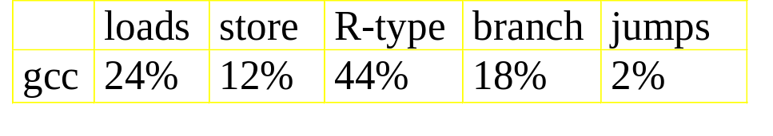
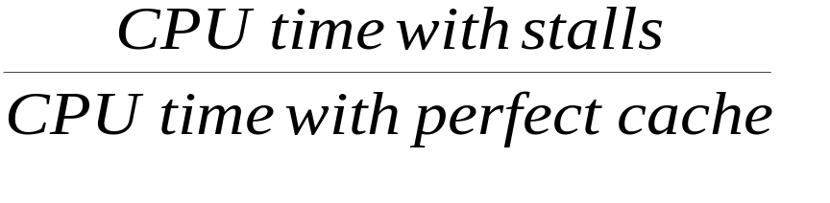
Cache Performance -- Example
Assume gcc
inst cache miss: 2%, data cache miss: 4%
CPI without memory stalls: 2
miss penalty for all misses: 100 cycles
Q1: how much faster a machine with a perfect cache (no misses)?
Q2: Average penalty cycles per instruction
  Inst miss cycles =
  Data miss cycles =

Slide 26
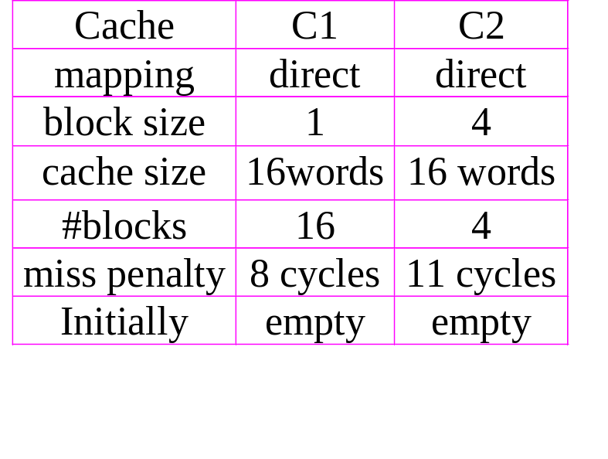
Example
Find a reference string for which C2 has lower miss rate but spends more cycles on cache misses

Slide 27
Average Memory Access Time
Hit time is also important for performance
Average memory access time (AMAT)
  AMAT = Hit time + Miss rate × Miss penalty
Example
  CPU with 1ns clock, hit time = 1 cycle, miss penalty = 20 cycles, I-cache miss rate = 5%
  AMAT =
    2 cycles per instruction

Slide 28
Embedded MIPS processor
  12-stage pipeline
  Instruction and data access on each cycle
Split cache: separate I-cache and D-cache
  Each 16KB: 256 blocks × 16 words/block
  D-cache: write-through or write-back
SPEC2000 miss rates
  I-cache: 0.4%
  D-cache: 11.4%
  Weighted average: 3.2%

Slide 29
Set Associative Cache--Motivation
Block size: 1 word
Memory size: 16 blocks
Cache size: 8 blocks
Access sequence: 0,8,0,8,0,8
Miss rate: 1
Reorganize cache such that each cache index has two blocks-- 2 way set associative
  miss rate reduced
2 way set associative cache
  a cache that has 2 locations where each block can be placed

Slide 30
Associative Caches
Fully associative
  Allow a given block to go in any cache entry
  Requires all entries to be searched at once
  Comparator per entry (expensive)
n-way set associative
  Each set contains n entries
  Block number determines which set
    (Block number) modulo (#Sets in cache)
  Search all entries in a given set at once
  n comparators (less expensive)

Slide 31
Comparison of 2 Caches with 8 words
Direct mapped cache with block size=2
  cache index: 2 bits
  4 cache sets, each set has ONE block of 2 words sharing same tag
  address translation:
2-way set associative
  cache index: 2 bits
  4 cache sets, each set has TWO blocks with different tags
  use of replacement policy
  address translation

Slide 32
Example: two-way set associative vs direct
memory size = 32, cache size = 8 words, direct cache has block size=2, set associative has block size =1
Access sequence:

Slide 33
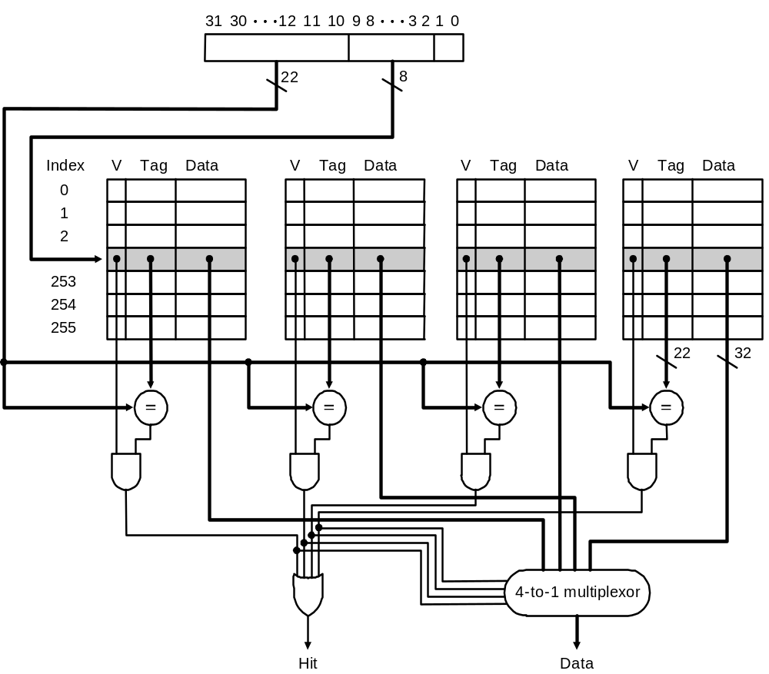
Implementation of 4-way associative cache
_{4 comparators}
_{4-to-1 mux}

Slide 34
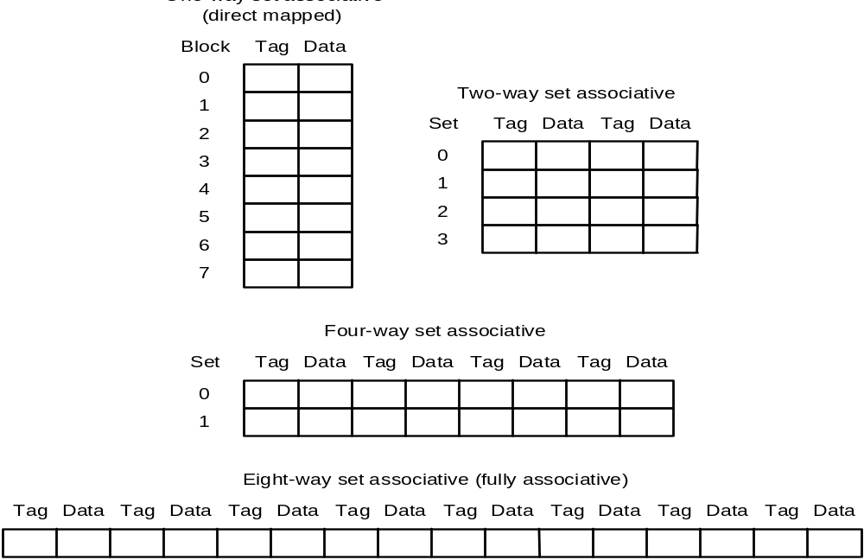
Decreasing miss ratio with associativity
Fully associative: A cache in which a block can be placed in any location in cache
Miss rate decreases, access time increases

Slide 35
How Much Associativity
Increased associativity decreases miss rate
  But with diminishing returns
Simulation of a system with 64KB
D-cache, 16-word blocks, SPEC2000
  1-way: 10.3%
  2-way: 8.6%
  4-way: 8.3%
  8-way: 8.1%

Slide 36
Decreasing miss penalty with multilevel caches
Add a second level cache:
  often primary cache is on the same chip as the processor
  use SRAMs to add another cache above primary memory (DRAM)
  miss penalty goes down if data is in 2nd level cache
Example: hit time (L1)= 1 cycle (cycle time =0.2 ns) with a 2% miss rate at L1 cache, 100 ns DRAM access. How much faster if we add L2 cache with 5 ns access time which decreases miss rate to main memory to 0.5%?
Using multilevel caches:
  try and optimize the hit time on the 1st level cache
  try and optimize the miss rate on the 2nd level cache

Slide 37
Cache-- Summary
Three address mapping:
  Direct
  Set associative
  Fully associative
Cache performance

Slide 38

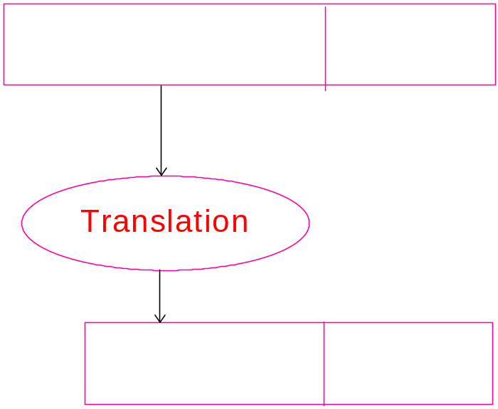

Virtual Memory
Main mem
Upper level: main memory
lower level: virtual mem. (disk)
Motivations: increase size of
memory system.
Page: a virtual mem. block
Page fault: a memory miss
Virtual address
physical address
address translation
Virtual mem (disk)
page size = = 4k

Slide 39
Addressing Mapping & Address Translation
Fully associative: a page can go any page frame in physical memory
Page table: tells if a page is in physical memory; if it is in, provides the physical address
  each program has a page table
  page table stored in main memory
Page table register: pointing to the page table

Slide 40
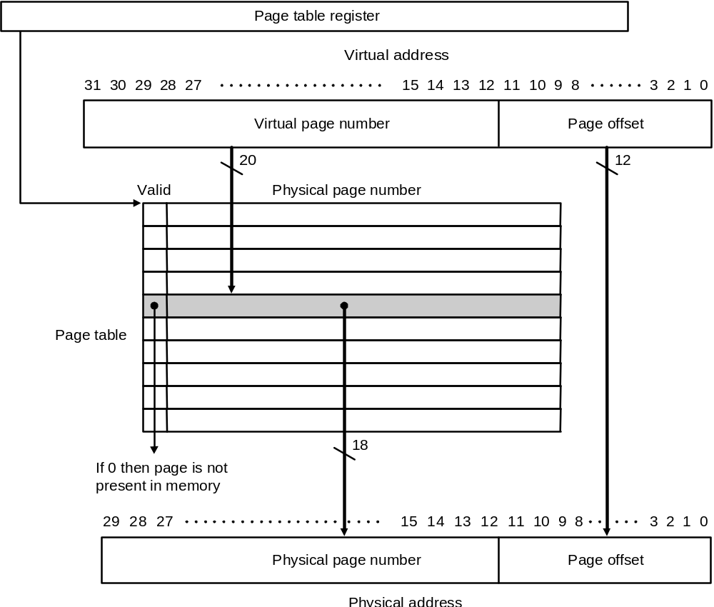
Page Tables--Translating virtual to physical address

Slide 41




Page table (con’t)
Page size = bytes = 4 KB
Virtual address space =
Physical address space =
# entries of page table =
Valid =
  1: page table item indicates the physical page number
  0: page table item indicates the location on disk
    have a page fault
    bring the page from disk to main memory
    insert the physical page # into the page table.

Slide 42
Replacement Policy
Page faults:
  how to find the missing page on disk?
  choosing a page to replace? LRU scheme
LRU (least recently used): replace the page least recently used
  reference bit in page table: each time a page is accessed, set ref bit =1; OS periodically clears ref. bit
Example
current access 8 is missing, which page to replace?
Reference order
10, 12, 12, 9, 7, 11, 10

Slide 43
Writes
Write through does not work
  big page -- 4 kbytes
  takes 100 ~ 1,000 cycles to write disk (startup penalty)
Write back: individual writes are accumulated into a page. The page is copied back to disk only when the page is replaced
Dirty bit : = 1 if the page has been written
0 if the page never changed
Each entry in the page table contains:

Slide 44
How to make address translation faster?
One step in address translation
  Use virtual page number to access page table—access main memory to translate address?
Another cache to hold part translation items in the page table -- TLB

Slide 45
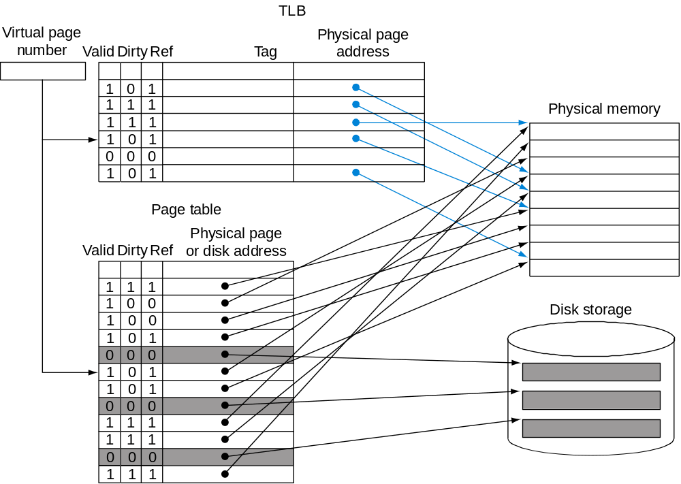
Making Address Translation Fast
A cache for address translations: translation lookaside buffer TLB
TLB: keeps track of recent address translations
An associative memory: access by content

Slide 46
Typical values: 16-512 entries,
_{miss-rate: .01% - 1%}
_{miss-penalty: 10 – 100 cycles}

Slide 47
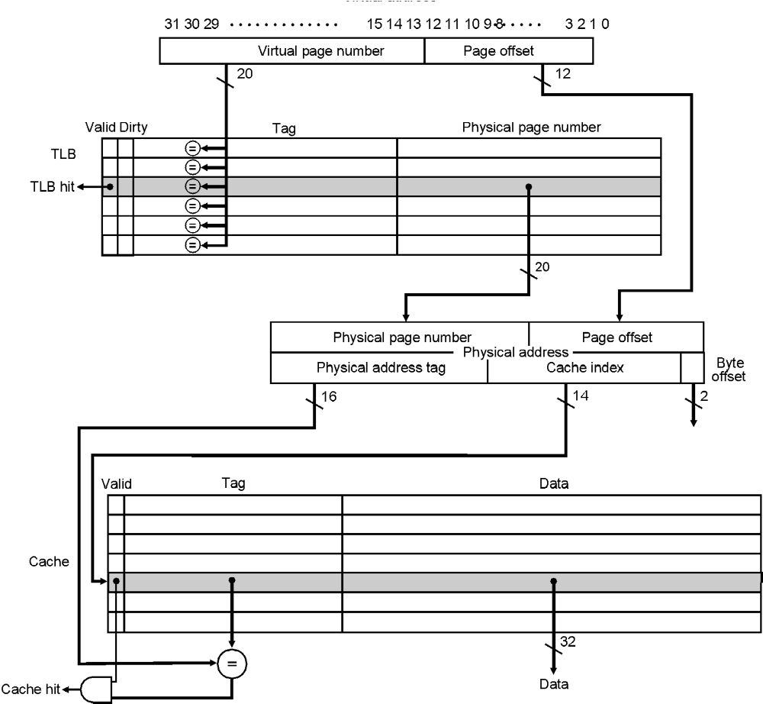

Slide 48
4 questions for TLB vs. page table
Mapping of page table items to TLB
Finding an item in TLB
Replace policy:
Writes:

Slide 49
Virtual Memory Summary
Concepts and motivations for virtual memory
Block = page: large (4 ~ 16 KB)
Mapping of virtual address to physical address
  fully associative
  page table
Replacement policy: LRU + reference bit in page table
Write-back
TLB

Slide 50
Big Picture
A common Framework for Memory Hierarchy
Q1: address mapping of lower level to upper level
  direct mapping
  set associative mapping
  fully associative mapping
Q2: how is a data found?
  index + tag comparison --- cache
  page table + page table register -- virtual memory
  fully search -- TLB
Q3: which block should be replaced? * Q4: writes
  in direct mapping: fixed - write through + write buffer
  random - write back + dirty bit
  LRU + ref. Bit

Slide 51
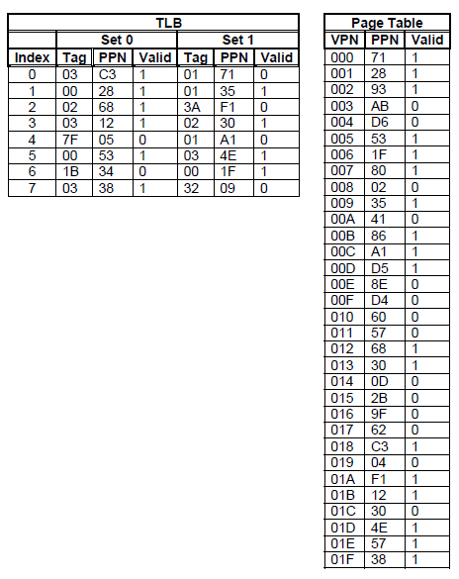
Imagine a system with the following parameters:
Virtual Address | 20 bits
Physical Address | 18 bits
Page size | 1KB
TLB | 2 way set associative, 16 total entries
The content of the TLB and the first 32 entries of the page table are shown (all numbers are in hex)
Show the number of bits used for the virtual page number and the virtual page offset
Show the numbers of bits used for the TLB tag and TLB index
How many entries are in the page table?
Show the number of bits used for the physical page number and the physical page offset
For the virtual address 0x078E6 what is the physical page number

